Slide 1
Company
Date
Buy, Hold, Sell…..Run Away?
Notes:
_narration_

Slide 2
Disclaimer
For Infotainment only
Notes:
Our AI systems are definitely not licensed financial advisors.
The information shown in the following is largely scraped from the Internet and you know how that usually goes, so beware.
Pause: 1.0
The information provided should not be considered financial advice. Any content or responses are for informational purposes only and do not constitute professional financial guidance. Decisions based on such information are at your own risk. Always consult with a qualified financial professional before making any investment or financial decisions. I do not endorse or promote specific financial products, and any discussions about financial concepts are general in nature. Individual financial circumstances vary, and it is crucial to conduct thorough research or seek personalized advice tailored to your situation.
Pause: 1.0
Use your own common sense and talk to the professionals before making any financial decisions.

Slide 3

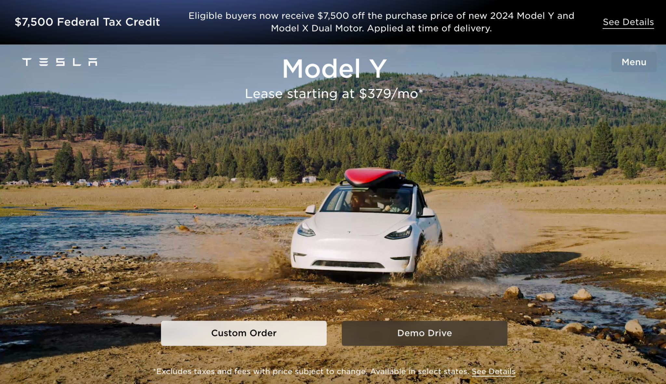
Tagline
Notes:
Tesla
Pause:1.0
Founded in 2003 by Martin Eberhard and Marc Tarpenning, Tesla, Inc. originated as an electric vehicle (EV) manufacturer with a mission to accelerate the world's transition to sustainable energy. The company gained prominence when entrepreneur Elon Musk led a substantial investment round in 2004, becoming a driving force in Tesla's development. Tesla's first product, the Roadster, debuted in 2008, showcasing electric cars' viability with impressive range. Over the years, Tesla expanded its lineup to include the Model S, Model 3, Model X, and Model Y, covering a range of market segments. Renowned for their performance, cutting-edge technology, and long-range capabilities, Tesla's vehicles have revolutionized the automotive industry, influencing a broader shift towards electric mobility. In addition to electric cars, Tesla has delved into energy solutions, producing solar products, energy storage systems like the Powerwall, Powerpack, and Megapack, and creating sustainable energy ecosystems. Tesla's innovative approach, spearheaded by Elon Musk, has positioned the company as a key player in both the automotive and clean energy sectors, driving global conversations about the future of transportation and environmental

Slide 4
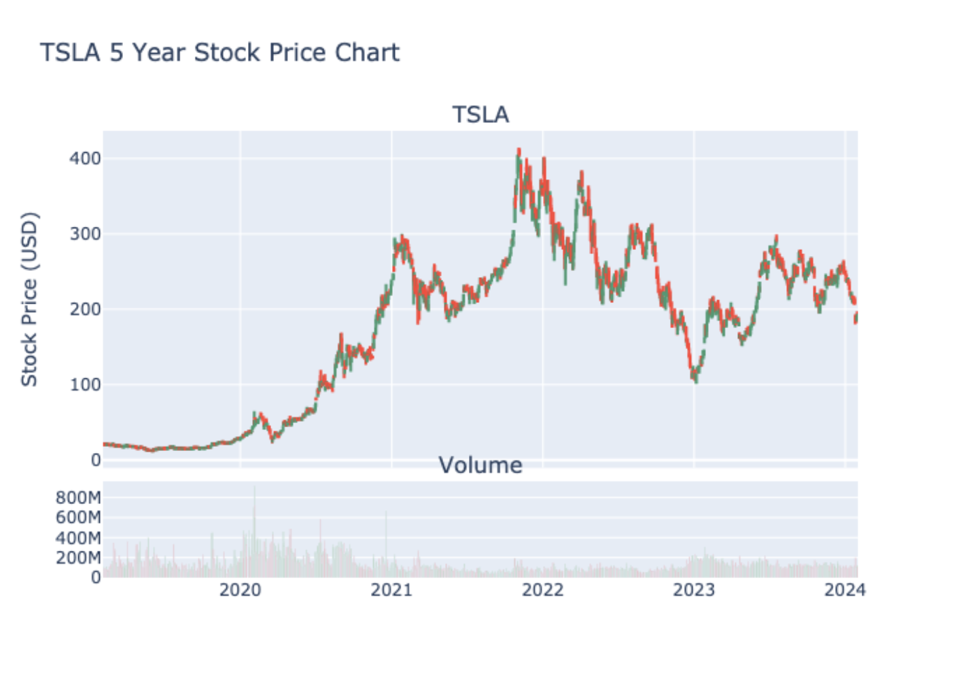
Stock Long Term
Notes:
_narration_

Slide 5
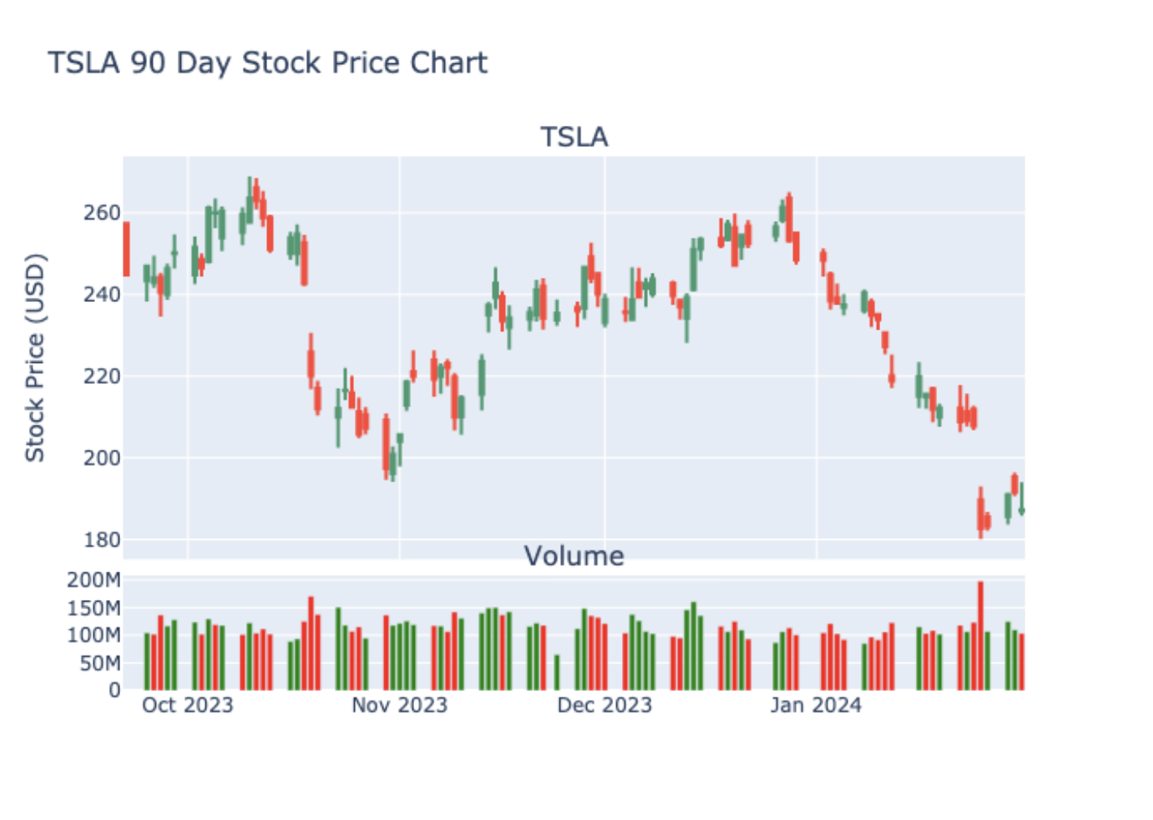
Stock Last Quarter
Notes:
_narration_

Slide 6
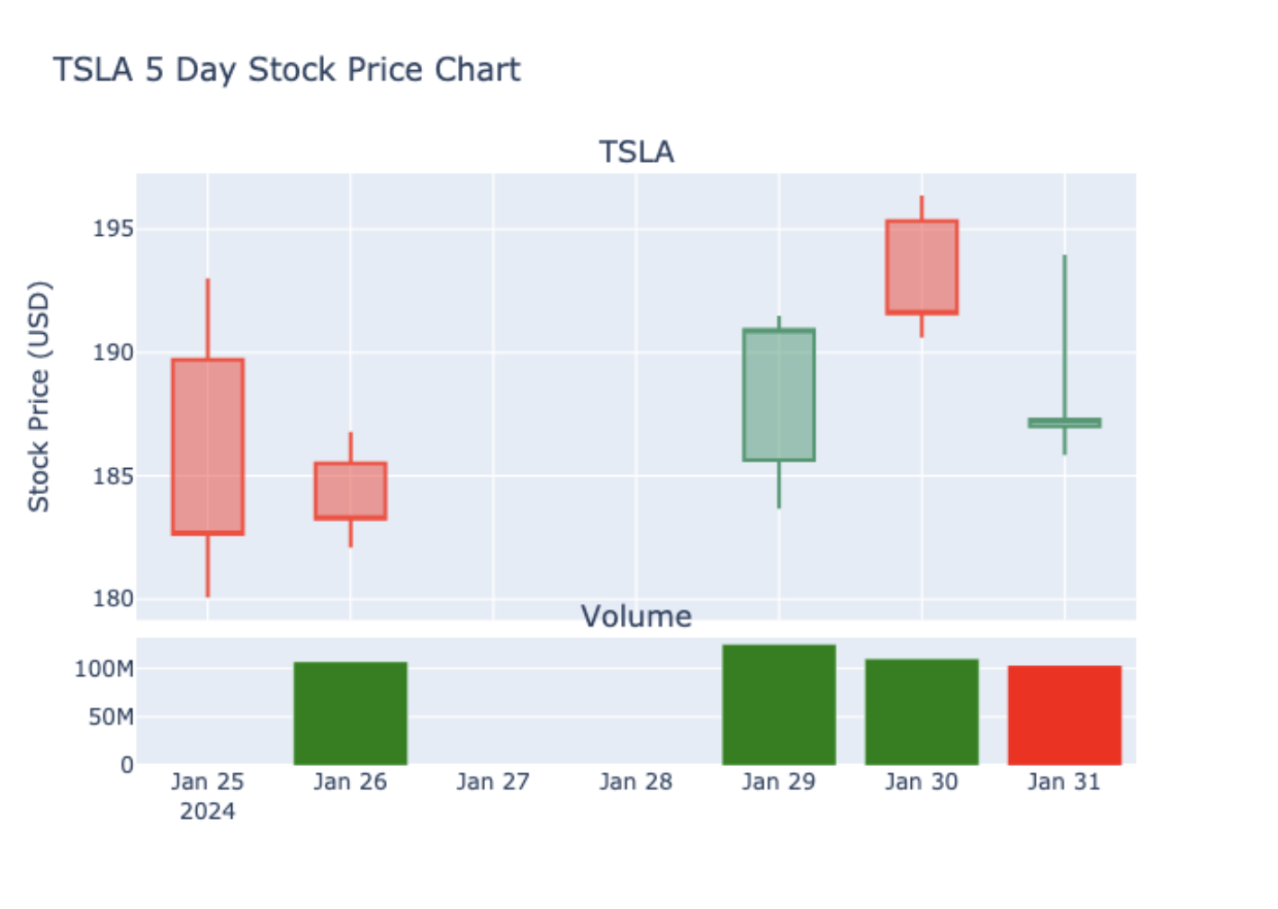
Past Week
A candle chart visually represents the price movement of a financial asset over a specific time period by using candlestick-shaped symbols to depict the opening, closing, high, and low prices for each interval.
Notes:
_narration_

Slide 7
Headlines
Headline1
Headline2
Headline3
Headline4
Headline5
Headline6
Headline7
Headline8
Notes:
_narration_

Slide 8
Direction
Notes:
_narration_

Slide 9
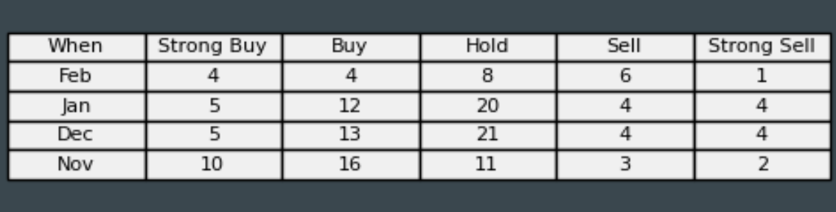
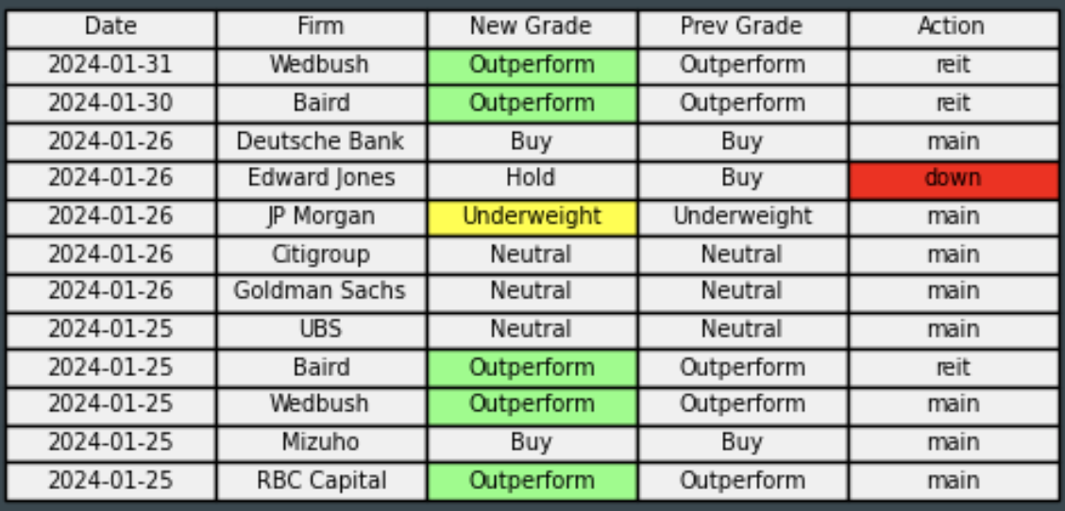
Analysts
Notes:
_narration_

Slide 10
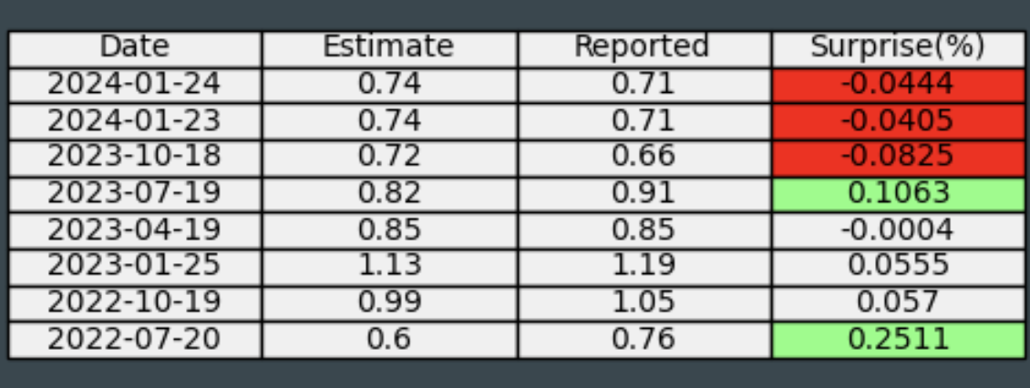
EPS
Next_EPS
Notes:
_narration_

Slide 11
Now some tech graphs
Notes:
And now some tech graphs…

Slide 12
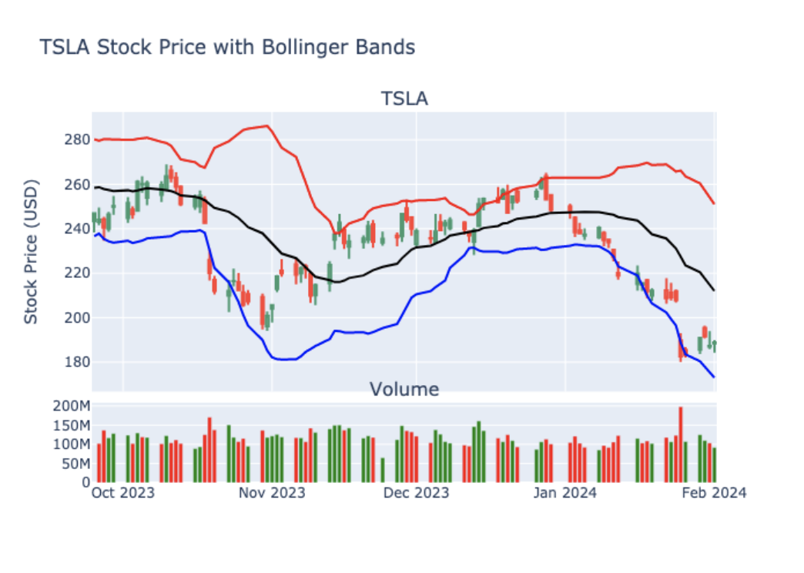
Bollinger Bands
Bollinger Bands are a volatility indicator consisting of a middle band being an N-period simple moving average, flanked by upper and lower bands representing N-period standard deviations from the moving average, used to identify potential overbought or oversold conditions in a financial instrument.
Notes:
_narration_

Slide 13
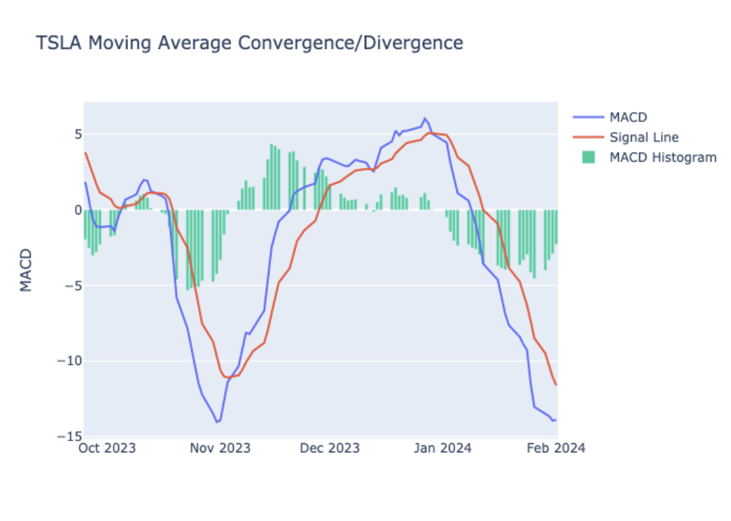
MACD
The Moving Average Convergence Divergence (MACD) is a trend-following momentum indicator that calculates the difference between two Exponential Moving Averages (EMAs) of an asset's price, revealing potential buy or sell signals when the MACD line crosses its signal line.
Notes:
_narration_

Slide 14
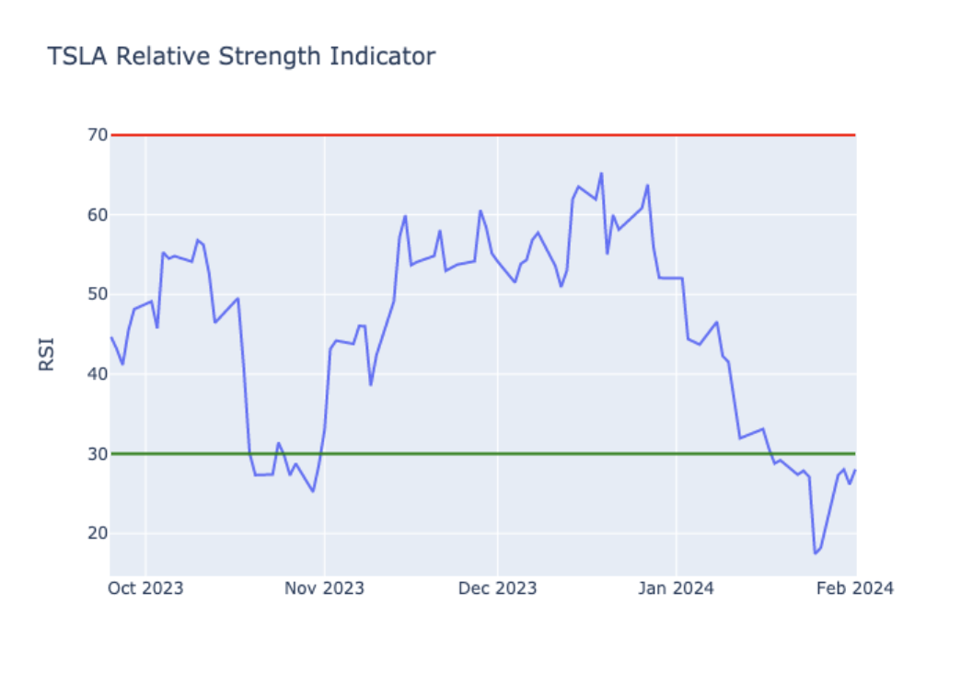
RSI
The Relative Strength Index (RSI) is a momentum oscillator that measures the speed and change of price movements, indicating potential overbought or oversold conditions for a stock, typically on a scale from 0 to 100. Above 70 is overbought and under 30 is oversold.
Notes:
_narration_

Slide 15
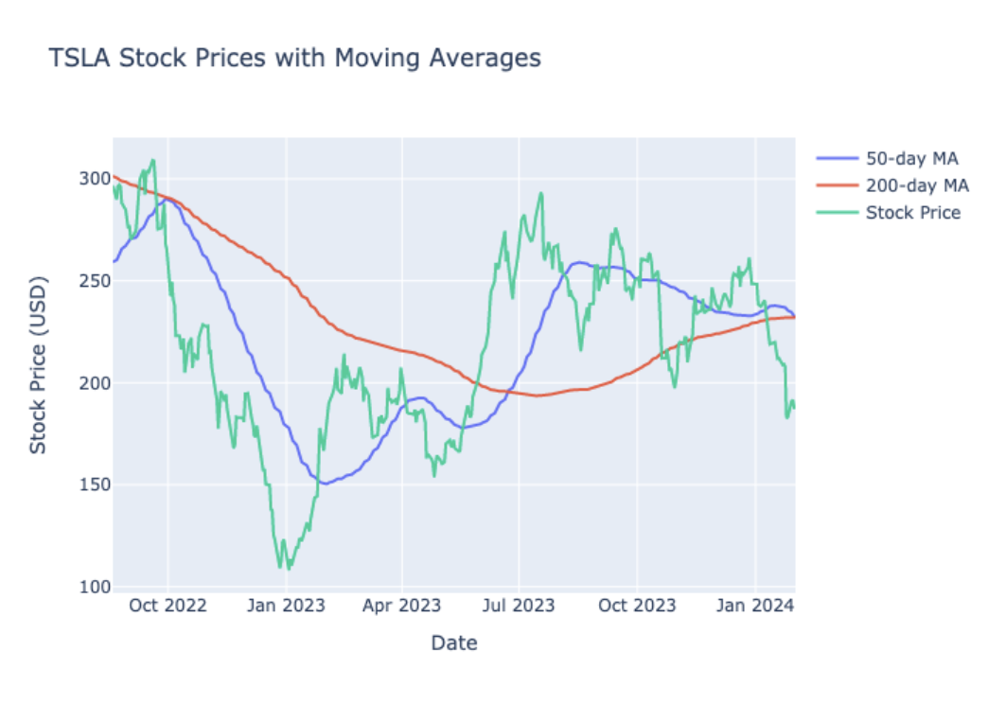
Moving Averages
The Relative Strength Index (RSI) is a momentum oscillator that measures the speed and change of price movements, indicating potential overbought or oversold conditions for a stock, typically on a scale from 0 to 100. Above 70 is overbought and under 30 is oversold.
Notes:
_narration_

Slide 16
Trend Lines
Notes:
_narration_

Slide 17
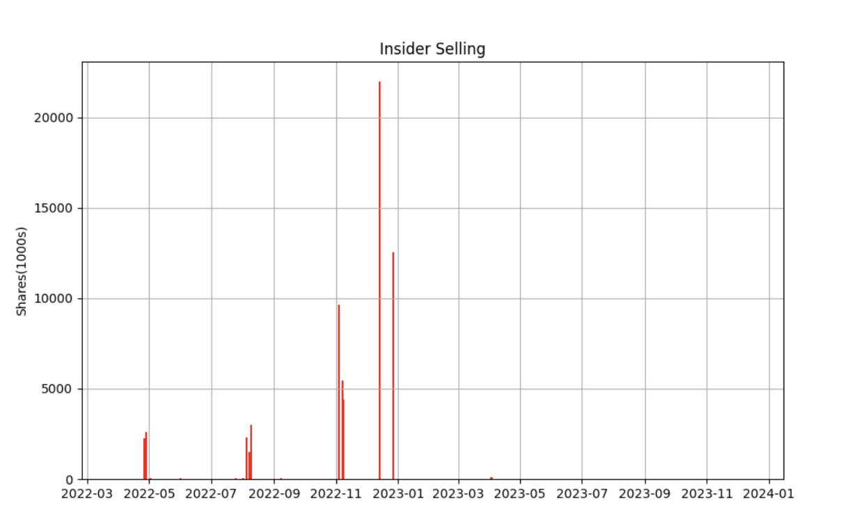
Insider Report
Notes:
_narration_

Slide 18
AI Price Prognostication
Today
$187.29
30 Days
$181.07
90 Days
$173.81
180 Days
$183.43
365 Days
$197.12
Notes:
_narration_

Slide 19
Summary
Notes:
_narration_

Slide 20
Recommendation
Notes:
_narration_

